Slide 1
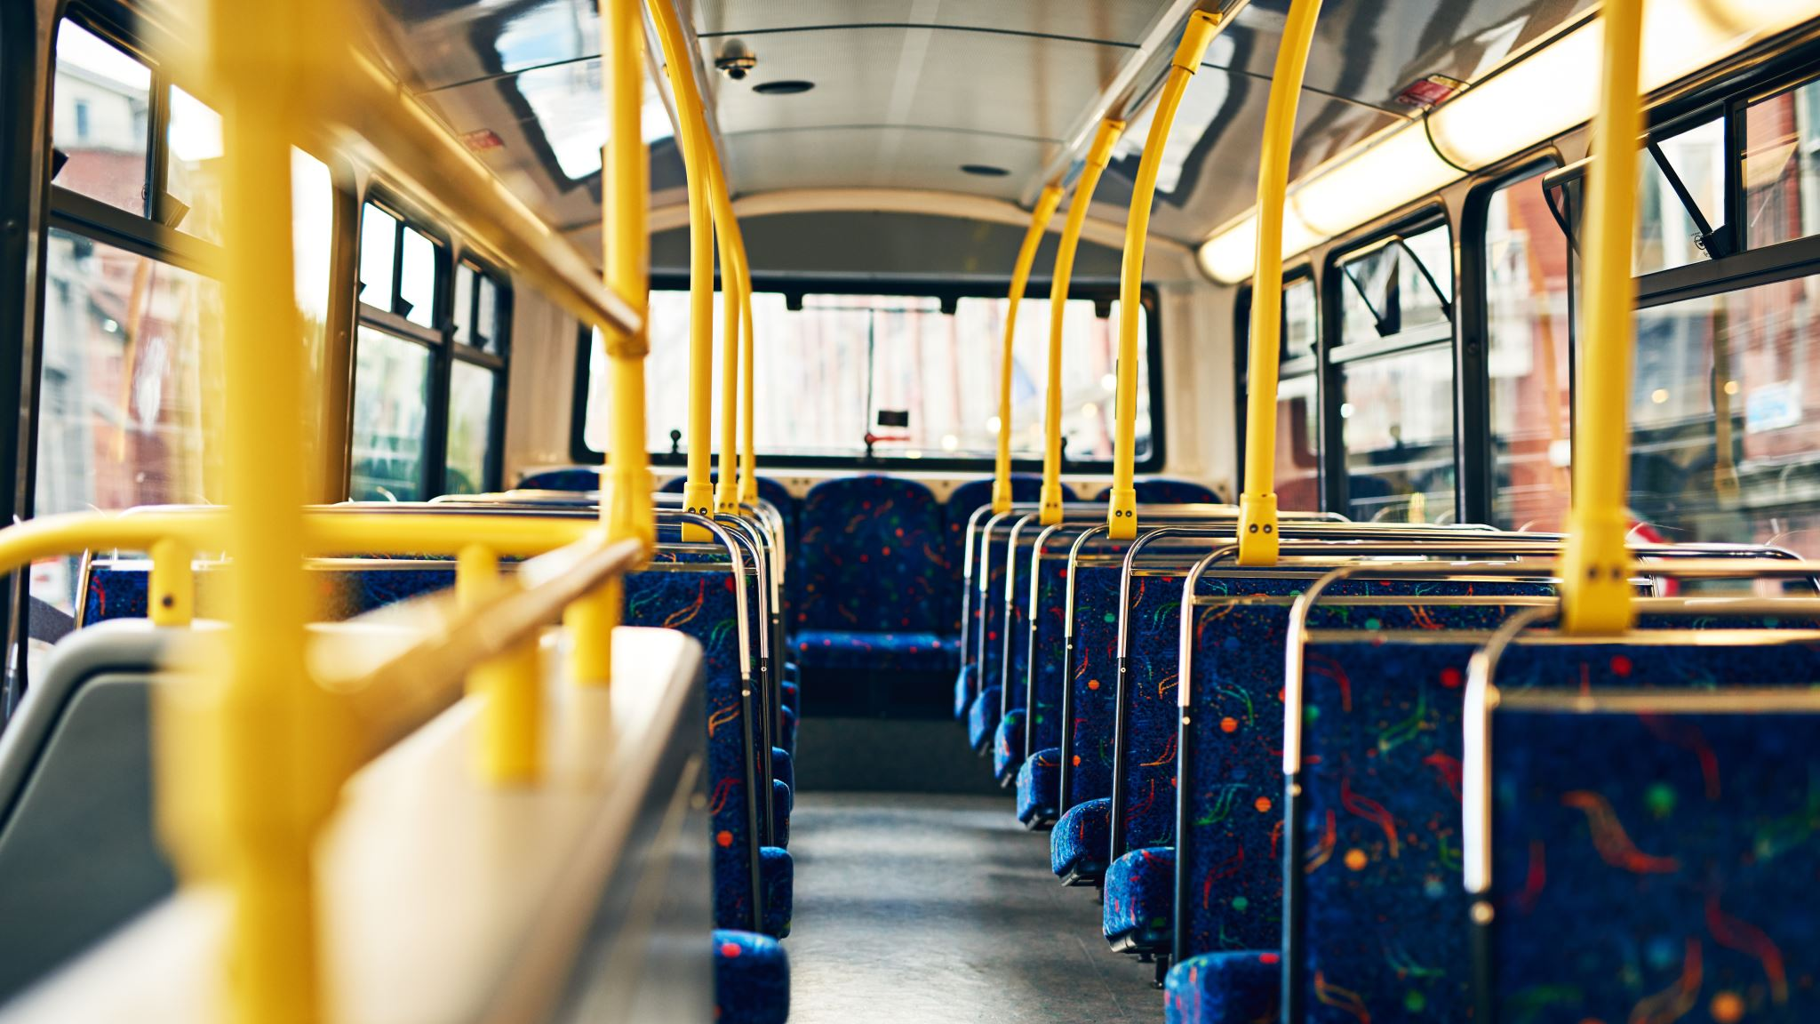
Field visit to Arapalayam bus stand for safety auditing

Slide 2
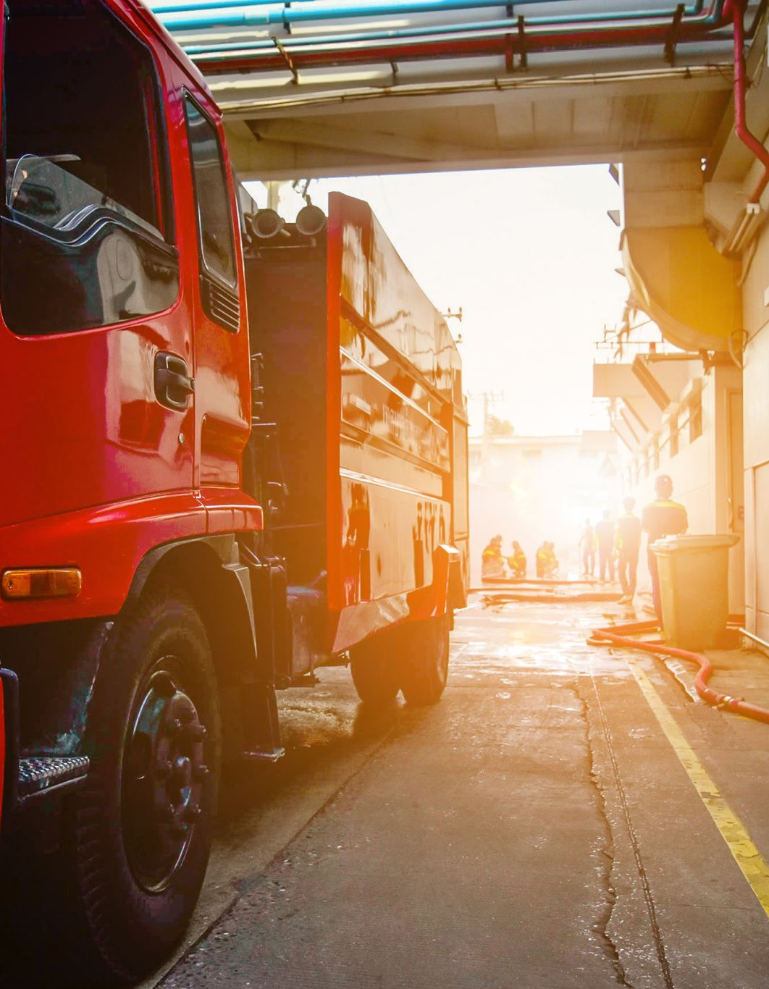
Safety audit:
A safety audit is a systematic review to analyze the risks and hazards in the workplace and evaluate the effectiveness and reliability of the safety procedures set up in the organization. It can be performed by internal or external safety officers.
To conduct a comprehensive safety audit at arapalayam bus stand to identify potential hazards, ensure compliance with current safety measures and provide recommendations for improving overall safety for passengers, staff and bus operators.

Slide 3
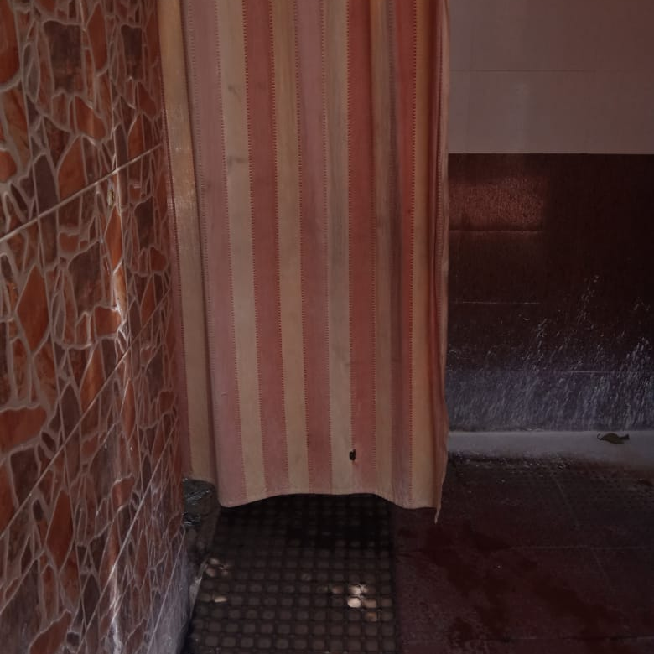
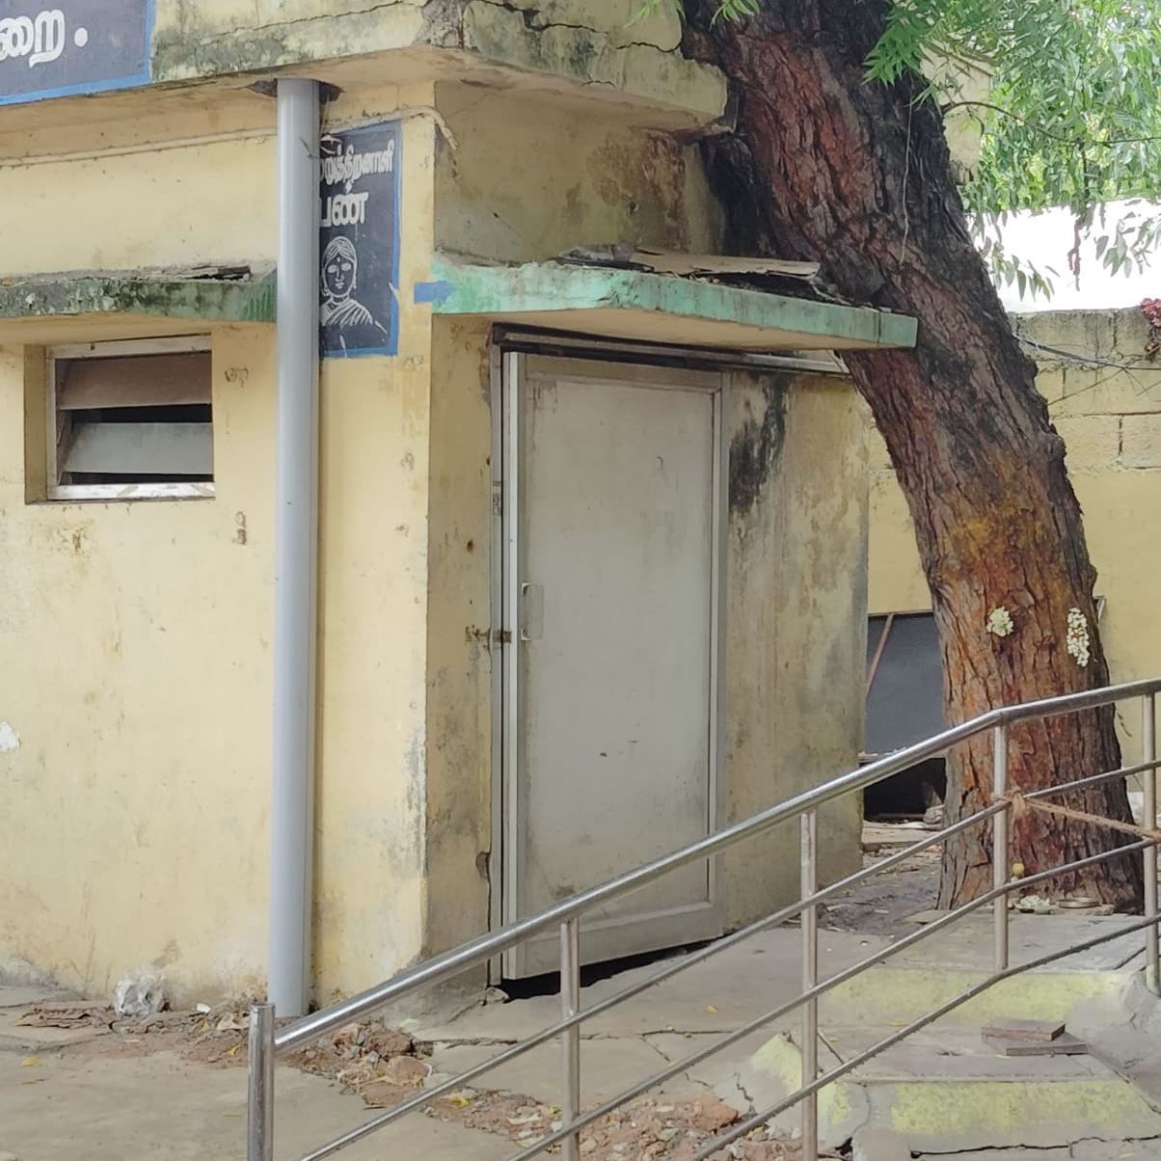
Observations:
The waiting area are spacious but lack sufficient seating capacity during peak areas. There are no designated areas for the specially challenged patients.
Directional and informational sign boards were unclear. No sign boards was there in the bus stand.
Many dustbins were observed to be overflowing leading to littering and attracting pests.
Restrooms were not adequately maintained several restrooms had only screens. Toilets for physically challenged persons were noy functioning.

Slide 4
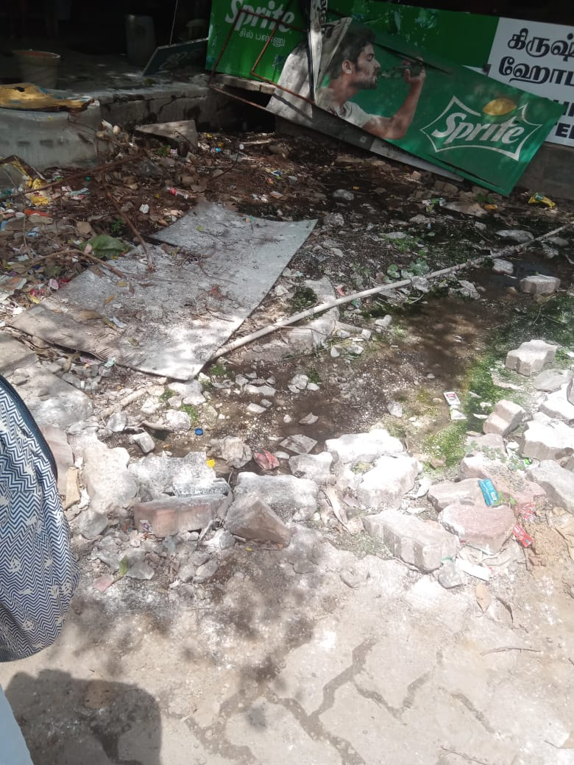
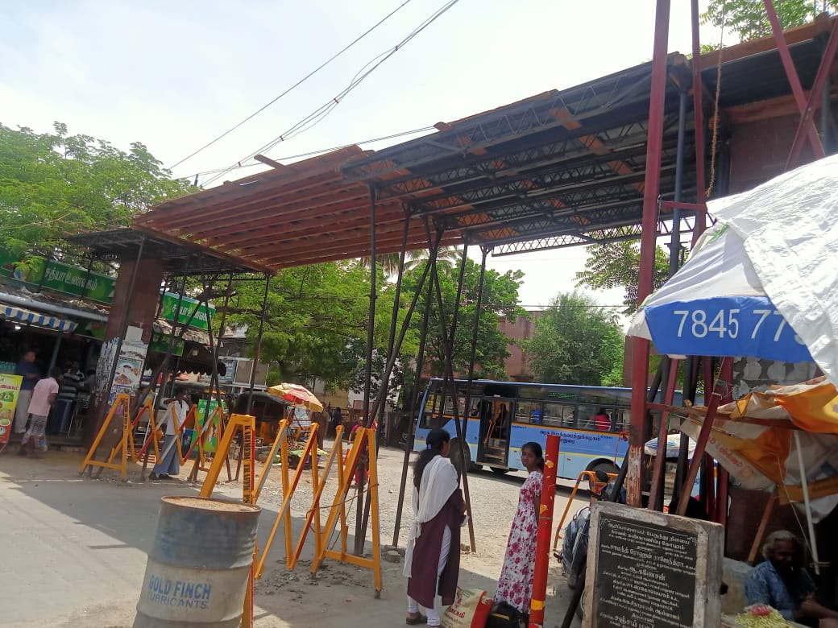
There were no available free-to-use toilets for visitors, creating inconvenience and discomfort.
The areas directly in front of the restrooms were found to be messy and untidy.
No proper barriers and clear signage are in place to restrict access to construction zones and alert the public to potential hazards.
Toilets lacked napkin destroyers, leading to improper disposal of sanitary products and hygiene concerns.

Slide 5
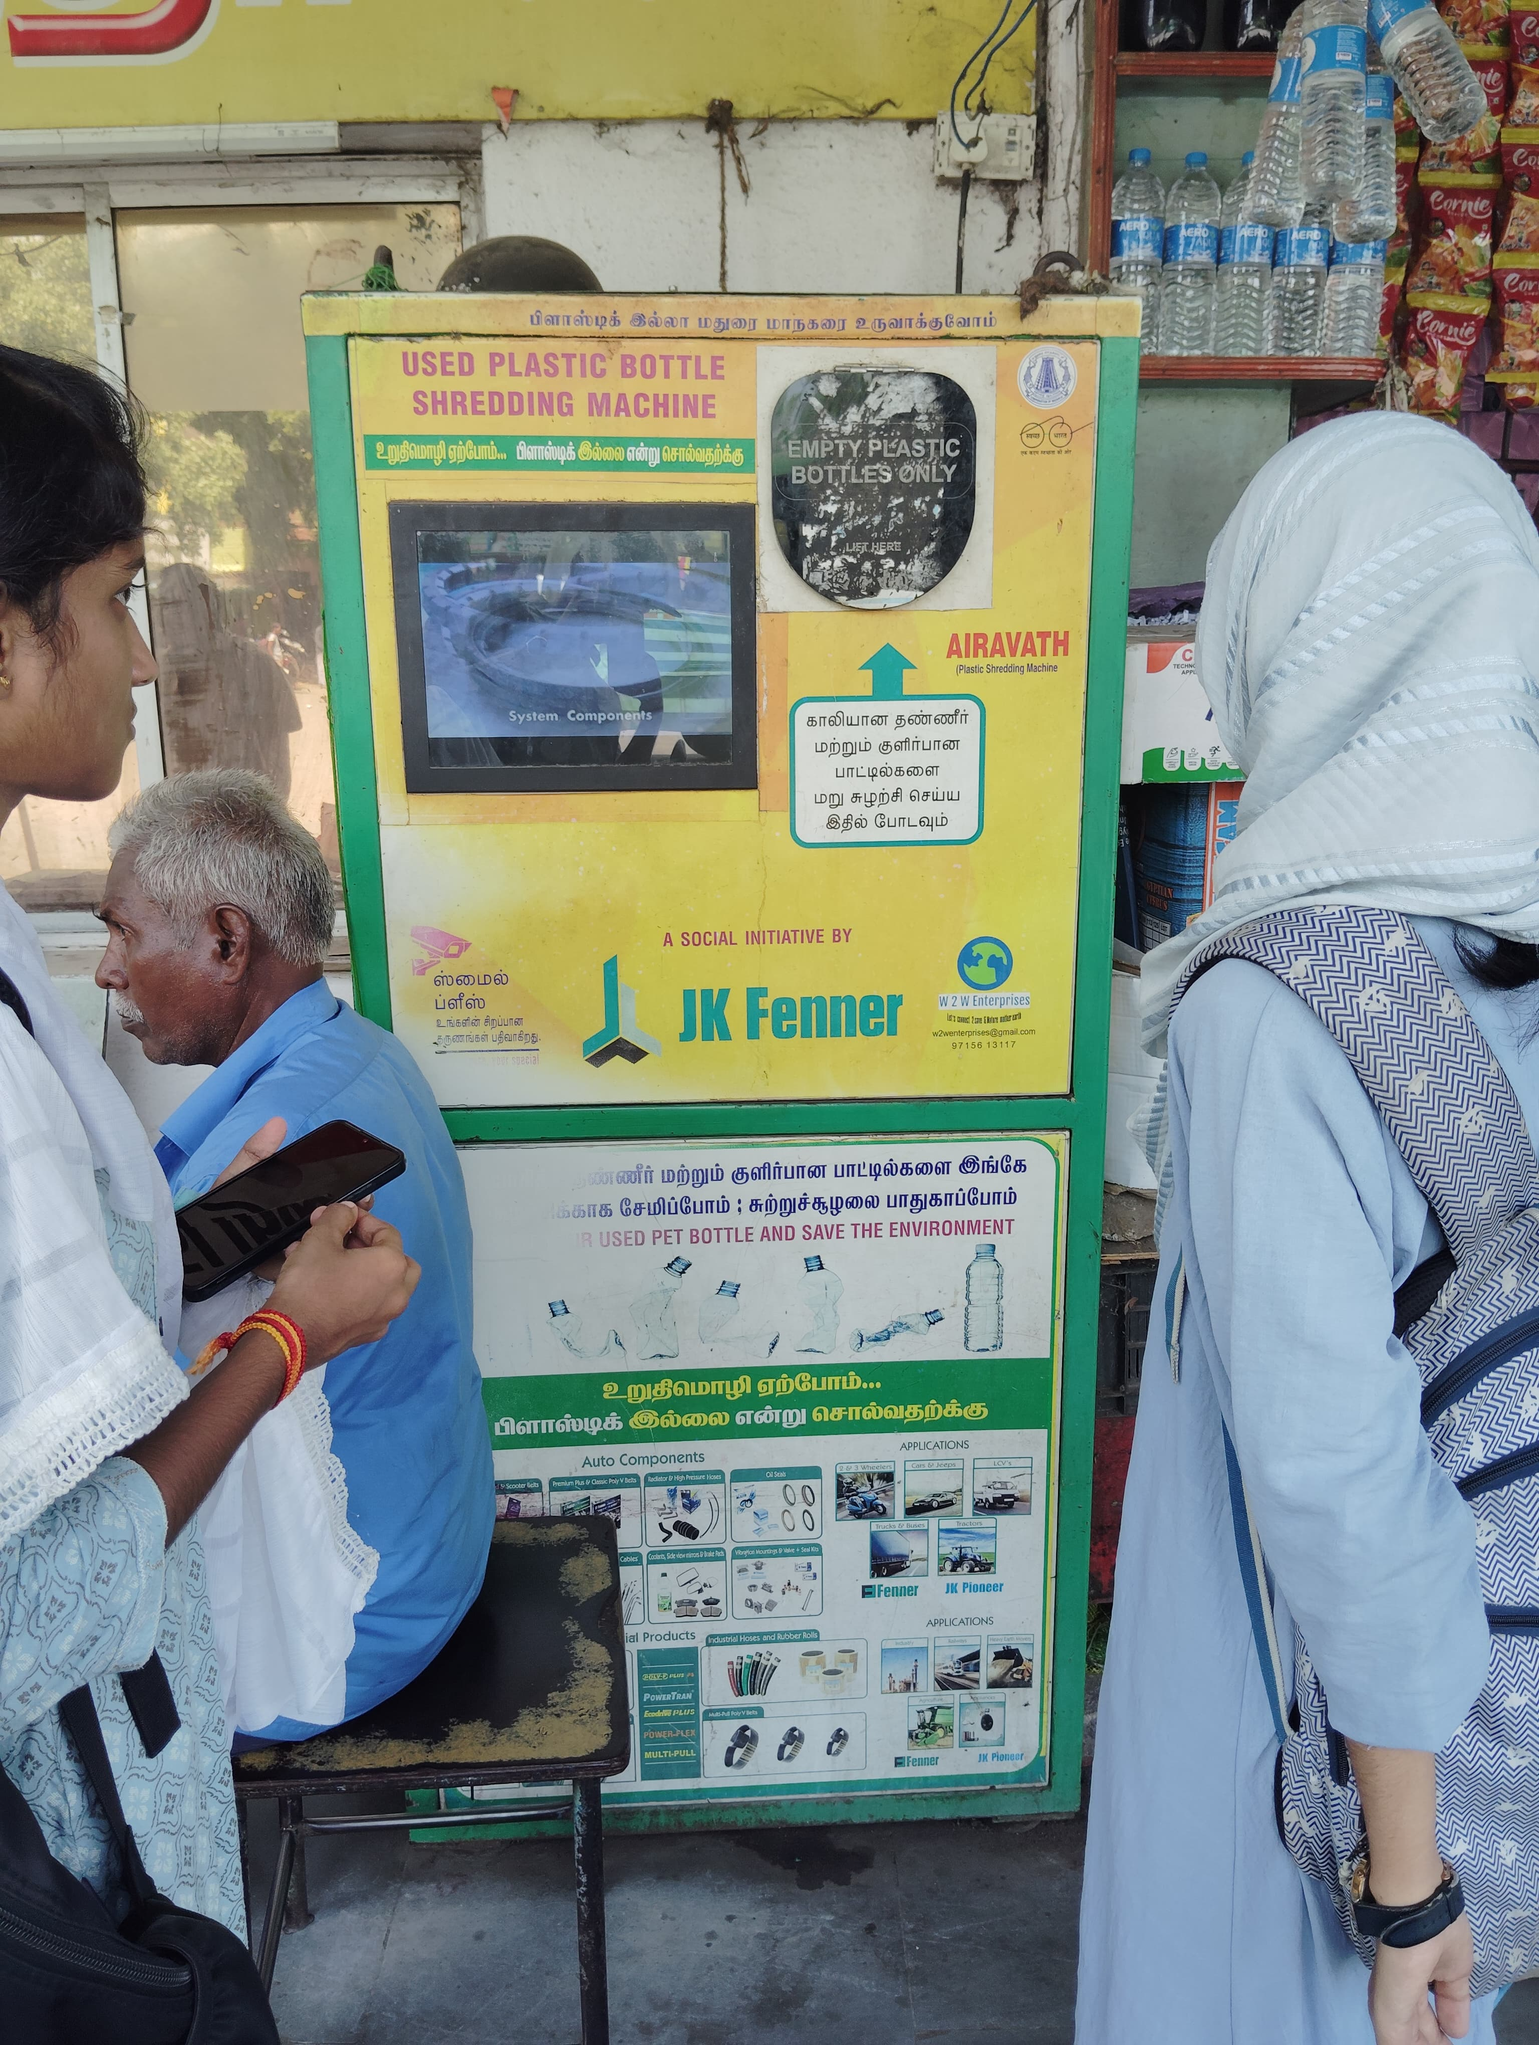
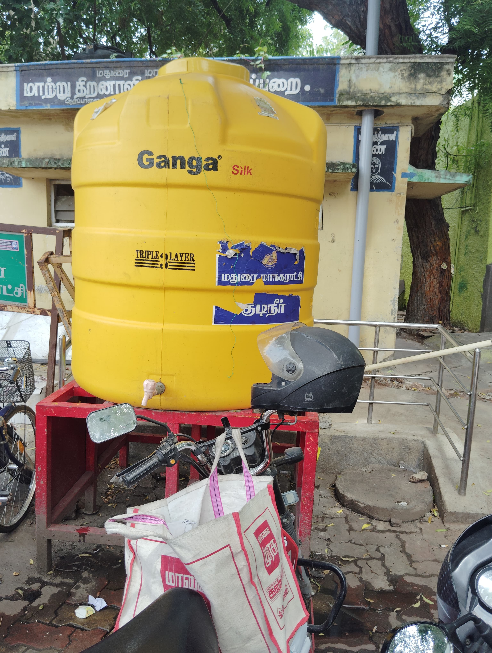
A plastic recycling machine was present in the bus stand.
Vehicles were parked Infront of the toilets creating a trouble for the passengers to reach the toilets.
Passengers were instructed to go safe due to the construction. The announcements was frequently given by the Madurai corporation
No electricity facilities in the bus stops.

Slide 6
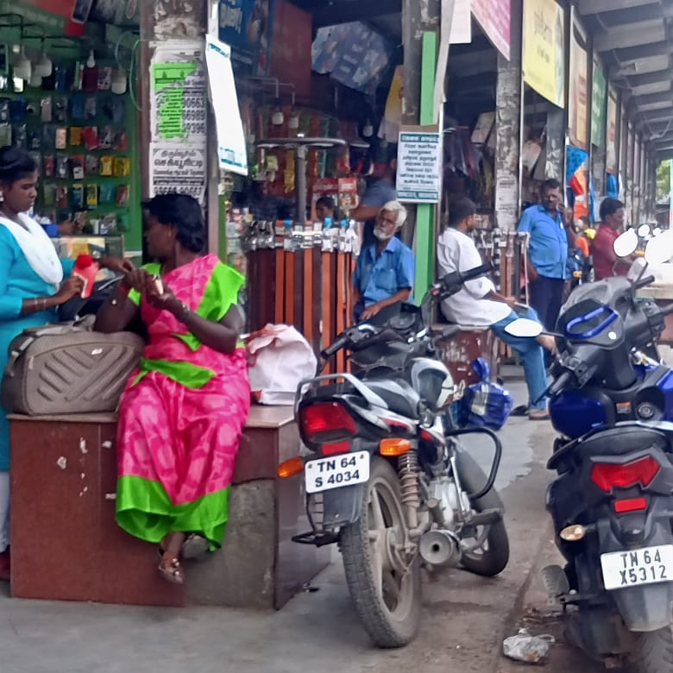
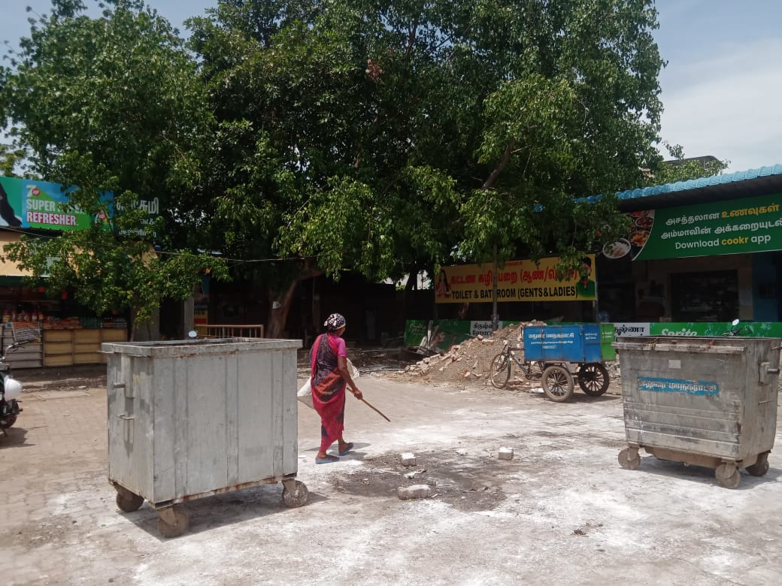
Vehicles were parked in designated pedestrian walking areas, obstructing pathways and posing safety hazards to pedestrians.
Dustbins were emptied of accumulated waste to maintain cleanliness and prevent overflow.
Bleaching powder was applied around the dustbins to disinfect the surrounding area and reduce odors
Efforts to gather public reviews were unsuccessful, with inadequate responses received.

Slide 7
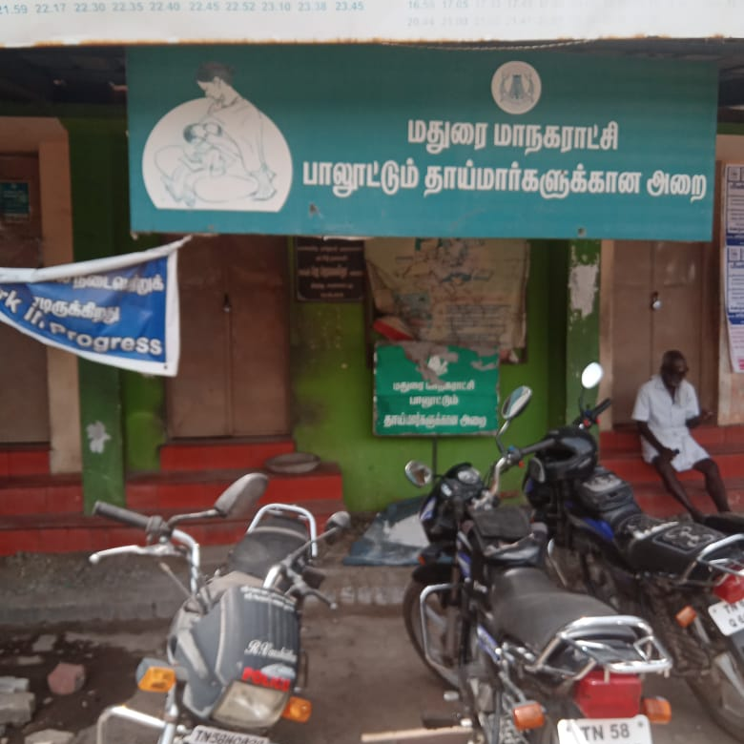
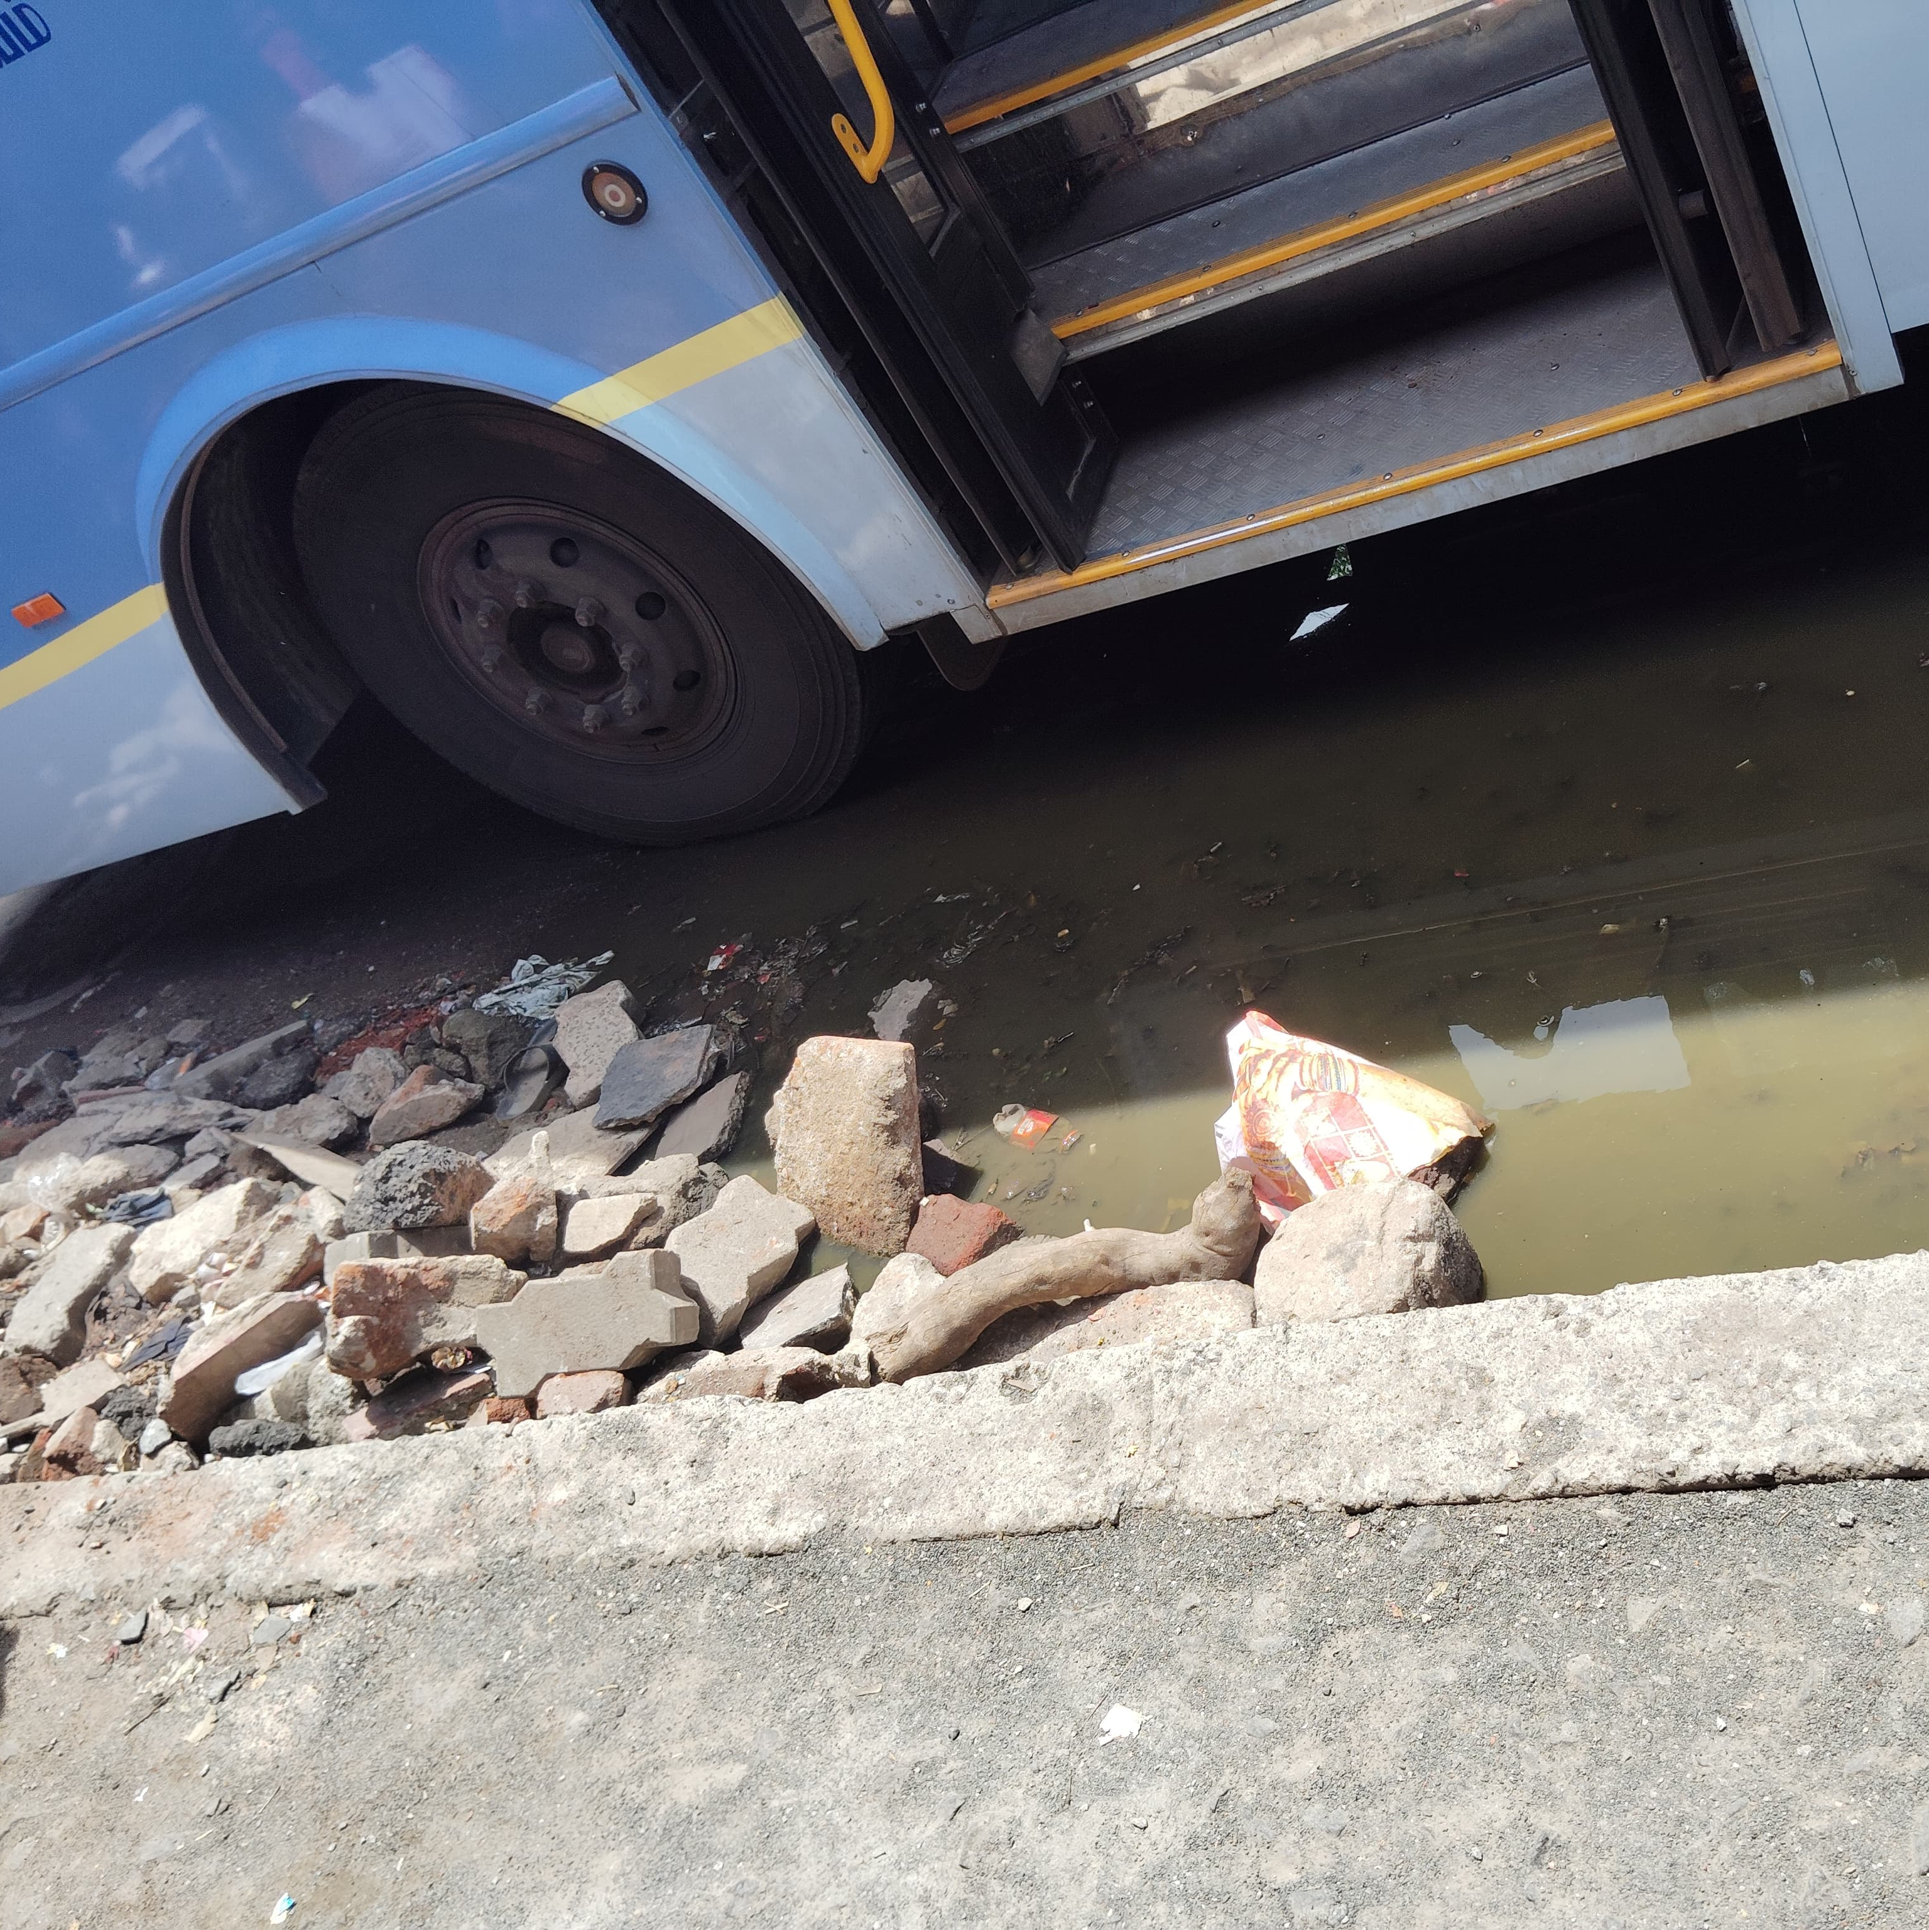
Bus stops were not maintained properly
There are some CCTV cameras installed, but the coverage is incomplete leaving several blind spots.
Several areas around the bus stand had stagnant drainage water creating a breeding grounds for mosquitoes and posing serious health risks.
Feeding rooms and also known as nursing rooms were not functioning.
People were smoking near the bus.

Slide 8
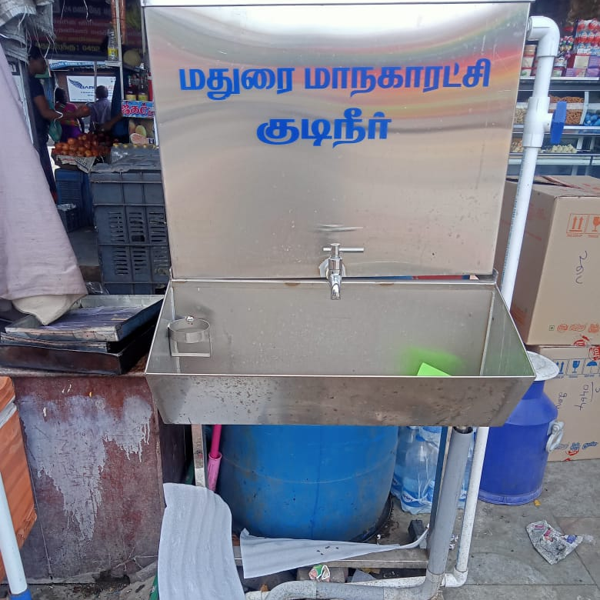
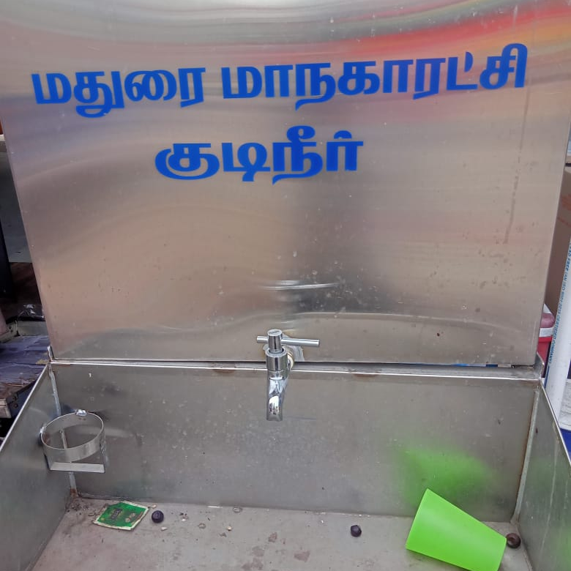
Drinking water were not maintained properly.
There are some CCTV cameras installed, but the coverage is incomplete leaving several blind spots.
Cracked flooring can create tripping hazards, especially in high-traffic areas of the bus stand.
Inadequate lighting at the bus stand area can create dark spots and cause difficulty for the passengers to travel at night.

Slide 9
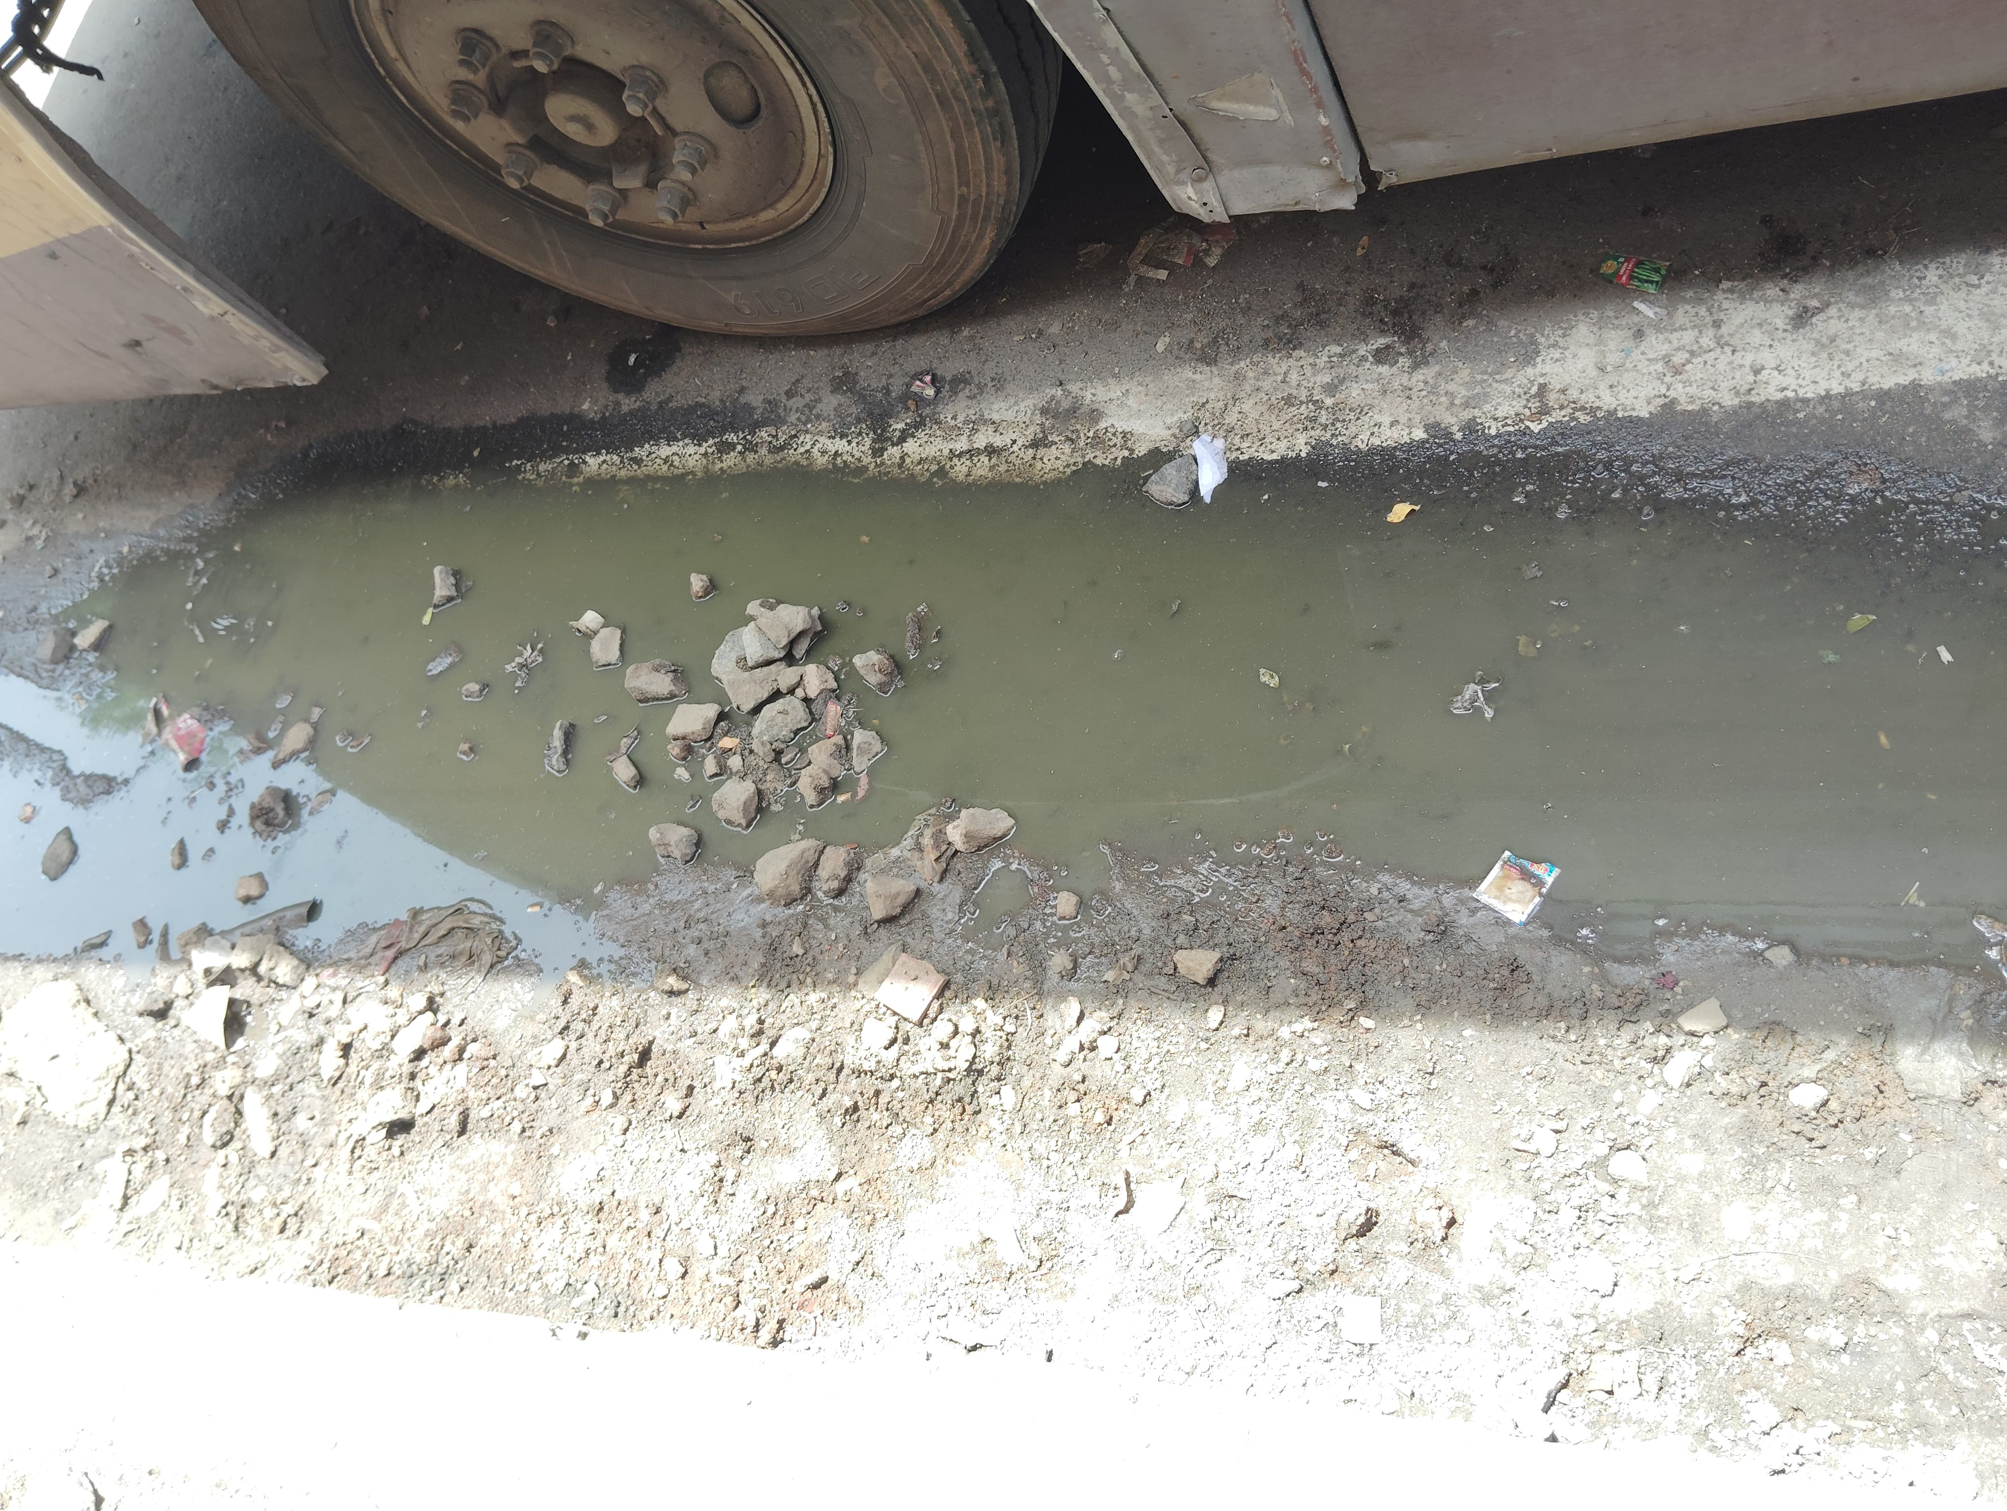
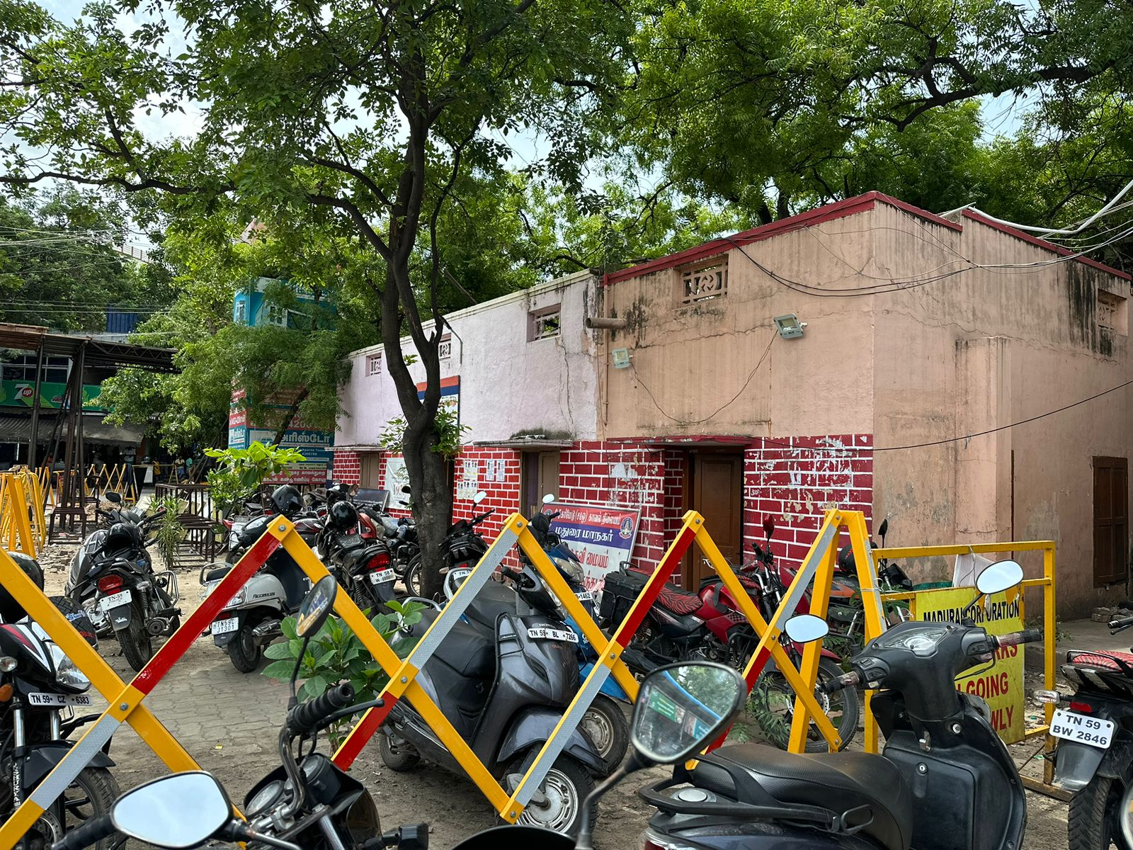
The police station was often unstaffed, with no officers present during several checks.
The police were not in rounds within the bus stand, leading to security concerns.
Essential safety equipment, such as fire extinguishers and first aid kits, were missing.
There was a significant amount of debris scattered around the bus stand, posing safety and hygiene risk.

Slide 10
Thank you

